Slide 1

Office of General Counsel
Bankruptcy at the Beach
September 10, 2021
Roman.Shaul@alabar.org
Alabama State Bar
Montgomery, Alabama

Slide 2


Slide 3
What is New at the
Alabama State Bar?
New Executive Director - Terri Lovell Bozeman.
New Bar President - Taze Shepard. (Gibson Vance is President-Elect)
Please check out “Member Benefits.” https://www.alabar.org/members/benefits/
Sign up for “The Scoop.” – Melissa.Warnke@AlaBar.org

Slide 4
Alabama State Bar
Office of General Counsel

Slide 5
2020 Disciplinary Stats
Complaints Received 854
Complaints Screened Out 898
Formal Investigations Opened 202
Private Reprimands 16
Public Reprimands 5
Transfer (Rule 27) 7
Suspensions 25
Disbarments 6
Surrender of License 1
Formal Opinions Issued 0
Informal Opinions Issued 2750

Slide 6


Beware Criminal and Family Law?

Slide 7
Can an Alabama Lawyer be sanctioned for private conduct?
Answer: YES

Slide 8
Rule 8.4, Ala. R. Prof. C.
Misconduct
It is professional misconduct for a lawyer to (or…“you ought not”):
…
(d) Engage in conduct that is prejudicial to the administration of justice
…
(g) engage in any other conduct that adversely reflects on his fitness to practice law.

Slide 9
Common Violations of
Alabama Rule 8.4(g)
Attorneys getting arrested.
Social Media Outbursts.
Outrageous conduct not subject to a criminal penalty.

Slide 10
Recent Example
Attorney initially spoke with a male African-American representative before being transferred to a female representative. During the recorded conversation with the female representative, attorney stated:
“I’ll tell you what; look here you fucking bitch. I’m just going to haul you into fucking court. Go fuck yourself, you fucking cunt. You’re about as much help as that fucking n****r that I spoke with. “
Attorney later exclaimed: “Fuck you. Fuck you, you bitch.”
Attorney also stated as follows:
“There’s some . . . I promise you there’s somebody at Samsung that’s an Asian, that’s above you. No lady, no woman at Samsung is the highest level. I can promise you that. So there is somebody above you. I would like to speak with them, please.”
Attorney threatened the female representative when he stated,
“I will shoot you in the fucking head . . . I want you to go fuck a dick.

Slide 11

Most Common Bankruptcy
Disciplinary Issues

Slide 12

You MUST Communicate
With Your Clients

Slide 13
Rule 1.4 Communication
(a) A lawyer shall keep a client reasonably informed about the status of a matter and promptly comply with reasonable requests for information.
(b) A lawyer shall explain a matter to the extent reasonably necessary to permit the client to make informed decisions regarding the representation.

Slide 14
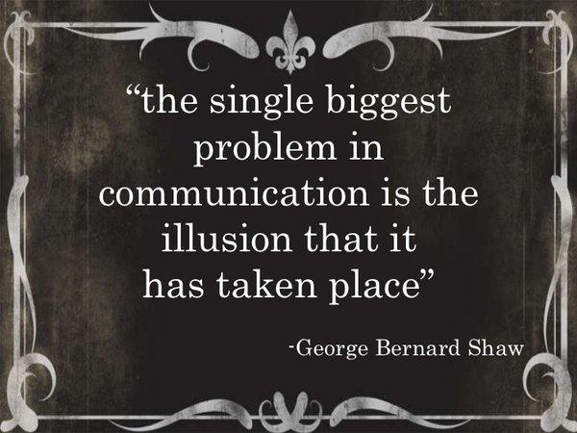

Slide 15
Rule 1.3 Diligence
A lawyer shall not willfully neglect a legal matter entrusted to him or her.

Slide 16

Cases Have to Keep Moving

Slide 17
Rule 3.2 Expediting Litigation
A lawyer shall make reasonable efforts to expedite litigation consistent with the interests of the client.

Slide 18
Rule 3.3: Candor Toward the Tribunal
(a) A lawyer shall not knowingly:
(1) Make a false statement of material fact or law to a tribunal;
(2) Fail to disclose a material fact to a tribunal when disclosure is necessary to avoid assisting a criminal or fraudulent act by the client; or,
(3) Offer evidence that the lawyer knows to be false. If a lawyer has offered material evidence and comes to know of its falsity, the lawyer shall take reasonable remedial measures.

Slide 19
Rule 3.3: Candor Toward the Tribunal
(b) The duties stated in paragraph (a) continue to the conclusion of the proceeding, and apply even if compliance requires disclosure of information otherwise protected by Rule 1.6.
(c) A lawyer may refuse to offer evidence that the lawyer reasonably believes is false.
(d) In an ex parte proceeding other than a grand jury proceeding, a lawyer shall inform the tribunal of all material facts known to the lawyer which will enable the tribunal to make an informed decision, whether or not the facts are adverse.

Slide 20

Splitting Fees

Slide 21

Failure to Check for Bankruptcy Filing

Slide 22

Proposed Rule Changes

Slide 23
Rule 7 Series Advertising
Proposed Changes
Removing the word “Advertisement.” Everything referred to as a “communication.”
Some changes are partly based on the ABA update to the model rules of professional conduct (August 2018).
Part of the proposed changes are designed to capture social media content.
No actors allowed in commercials for victim statements. Must use actual victims (or representative if victim is deceased).
Lawyers should retain relevant communications for six years. Six years is the SOL for a disciplinary violation. Communications are no longer required to be submitted to the OGC.

Slide 24
Rule 7 Series Advertising
Proposed Changes
A lawyer who personally appears in a communication must include the city, county or town where their primary office is located.
Any lawyer appearing in a communication must disclose if they are not licensed in Alabama.
Removes the general disclaimer. However, the prohibition on comparing legal services of other lawyers is in force and is now codified.
Some new disclaimers will be required for communications concerning past results and any communication that includes a dramatization of an event.
Limits ability of competing lawyers to purchase search terms that are trade names of other law firms or in some instances, associated with other law firms.

Slide 25

Banner Ads

Slide 26
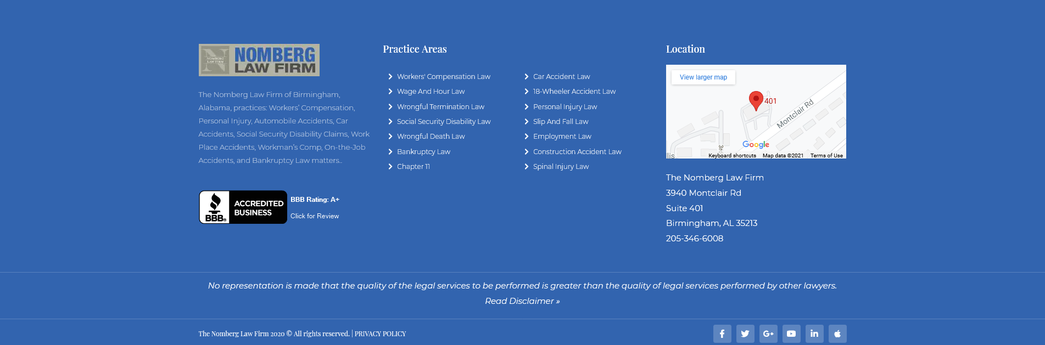
Keep your “Home Page” current

Slide 27
Disciplinary Rule Changes

Slide 28
New Disciplinary Rules
Three main sets of Rules:
Alabama Rules of Professional Conduct.
Alabama Rules of Disciplinary Procedure.
Alabama Standards for Imposing Lawyer Discipline.

Slide 29
New Disciplinary Rules
Alabama Rules of Disciplinary Procedure changes became effective July 23, 2021.
We had no formal advance notice they were being issued.
We were not asked our thoughts on any of the changes – either before or after issuance.
There were no comments or guidance offered with the rule changes.
The OGC is preparing a response to the changes to seek clarification of certain rules.
There was nothing in the rule changes that says they are retroactive.

Slide 30
New Disciplinary Rules
Rule 3(c) – The Supreme Court can now initiate its own investigation into any lawyer who is a member of the Alabama State Bar.
**The assumption here is that the Court, as a whole, would have to initiate an investigation and not just an individual justice.

Slide 31
New Disciplinary Rules
Rule 12 (c) – All complaints against:
Members of the BBC (silent as to the Bar President)
Lawyers employed by the Bar (including ED and GC; and
Any Hearing Officer,
**Must be sent to the Alabama Supreme Court within 14 days.
**This will be sent to the Court before you get to answer the allegations and there will be no screen out procedure like other attorneys.
**Supreme Court will decide who investigates the complaint and will decide by majority vote whether the complaint is to be dismissed; referred to the Disciplinary Board; or other discipline imposed.

Slide 32
New Disciplinary Rules
Rule 6 (c) -
“The Board of Bar Commissioners’ decisions concerning the appointment of the General Counsel, the General Counsel’s compensation, and the termination of the General Counsel’s employment shall be subject to the approval pf the Supreme Court of Alabama.”
** What about other employees in the OGC?
**This is the way disciplinary offices are set up in voluntary bar associations and hybrid bar associations.

Slide 33
New Disciplinary Rules
Rule 12(e) – Disciplinary Clerk must send notice of all dismissals to Supreme Court Clerk within 14 days.
Rule 12(f)(1) – OGC has a right to appeal dismissals.
**work product issues
Rule 12(f)(5) – For all suspensions and disbarments that are not appealed - the Disciplinary Clerk must provide the full record to the Supreme Court within 14 days of the expiration of the appeal deadline.
**This is a very expensive requirement and may
have to pay expedited fees.

Slide 34



Social Media and Ethics
What you follow, follows you

Slide 35


Slide 36

First – Don’t Post While Angry

Slide 37
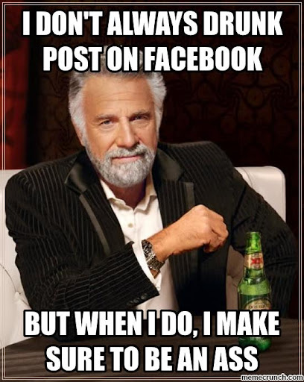
Second - Don’t Post While Drinking

Slide 38

Third –Don’t Post Disparagingly about Clients

Slide 39
Example
The Office of General Counsel received copies of screen shots from a website, www.avvo.com. The website allows clients to post comments regarding their lawyers. On the website, a former client posted an anonymous negative review.
The Alabama attorney responded to the negative review by posting an online response attacking his former client and revealing confidential information.
The lawyer posted that… “the client was ignorant” . . . “had been charged with DUI, a drug charge, and also had a previous divorce case”… “the client had been locked up in the looney bin” for months due to “numerous and severe” psychological conditions. The lawyer also told the client to “show some fortitude and man up boy.”

Slide 41
It is Ok to Post About Your Cases…But,
The Virginia Supreme Court held in Hunter v. Virginia State Bar, 744 S.E.2d 611 (Va. 2013), that confidentiality obligations have limits when weighed against a lawyer’s First Amendment protections.
Specifically, the court held that although a lawyer’s blog posts were commercial speech, the Virginia State Bar could not prohibit the lawyer from posting non-privileged information about clients and former clients without the clients’ consent where (1) the information related to closed cases and (2) the information was publicly available from court records and, therefore, the lawyer was free, like any other citizen, to disclose what actually transpired in the courtroom.

Slide 42
Fourth – Don’t Post
About the Judge
Multiple federal prosecutors admitted to posting anonymously about several judges, pending investigations and cases.
Lawyer sends purported suicide note in which he makes several disparaging and reprehensible comments about several judges and lawyers.
A lawyer agreed to a public reprimand for harshly criticizing a judge in a blog post, using phrases such as “evil, unfair witch” and “seemingly mentally ill.”

Slide 43
Fifth – Don’t Post About
People Not Your Client
Assistant prosecutor disciplined for posting threats against his boss on Facebook.
A prosecutor was disciplined for commenting on Facebook during an attempted murder trial about “keeping the streets safe from Somalis.”
A lawyer posted nude photos of his ex-girlfriend--a prosecutor herself --on Twitter

Slide 44
Sixth – Don’t Post Credentials
You Do Not Have!
A lawyer received a public reprimand for violating advertising rules by false and misleading statements about his qualifications, such as listing 50 practice areas in which he had little or no experience.

Slide 45
Seventh - Avoid Communications with Represented Parties
Generally, you cannot “friend” an opposing party to gain access to their social media content. However, most jurisdictions allow you to view whatever is publicly available.
Similarly, do not accept a friend request from opposing parties.

Slide 46
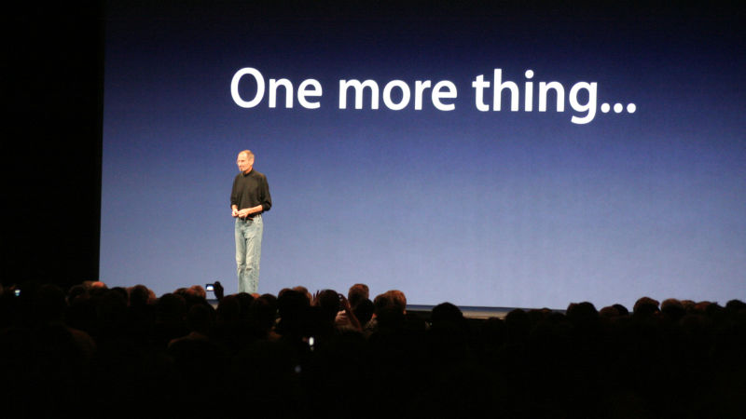
Important Tip on Social Media Use

Slide 47
Beware of Creating an
Attorney-Client Relationship
ABA Formal Opinion 10-457 recognized that enabling communications between prospective clients and lawyers, websites may give rise to inadvertent attorney-client relationships and trigger ethical obligations to prospective clients under MRPC 1.18.
The interactive nature of social media - inviting and responding to comments creates a real risk of inadvertently forming attorney-client relationships.

Slide 48


Slide 49

Don’t Rely on Your Friends for Ethics Advice

Slide 50
Rule 5.1 - Liability of
Supervisory Lawyers
(c) A lawyer shall be responsible for another lawyer’s violation of the Rules of Professional Conduct if:
The lawyer orders or, with knowledge of the specific conduct, ratifies the conduct involved; or
The lawyer…has direct supervisory authority over the other lawyer, and knows of the conduct at a time when its consequences can be avoided or mitigated but fails to take reasonable remedial action.

Slide 51


Slide 52
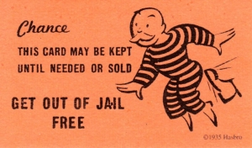
Why Get an Ethics Opinion?

Slide 53
Ethics Opinions
Alabama Rules of Disciplinary Procedure
Rule 18.
Conduct not subject to disciplinary action.
If, before engaging in a particular course of conduct, a lawyer makes a full and fair disclosure, to the Office of General Counsel, said inquiry shall be considered confidential. Additionally, if said lawyer receives a formal or informal opinion from the Office of General Counsel that the proposed conduct is permissible, such conduct shall not be subject to disciplinary action.

Slide 54

Most Common Ethics
Questions in Bankruptcy

Slide 55
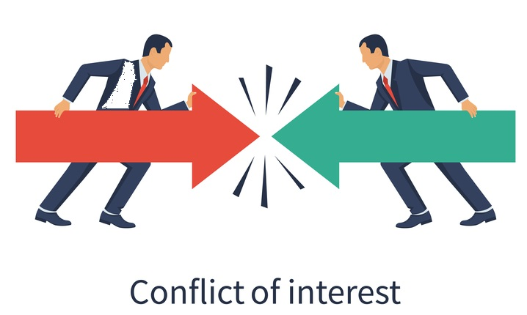

Slide 56
Rule 1.7 Conflict of Interest:
General Rule
(a) A lawyer shall not represent a client if the representation of that client will be directly adverse to other clients, unless:
(1) The lawyer reasonably believes the representation will not adversely affect the relationship with the other client; and
(2) Each client consents after consultation.

Slide 57
Rule 1.7 Conflict of Interest:
General Rule
(b) A lawyer shall not represent a client if the representation of that client may be materially limited by the lawyer’s responsibilities to another client or a third person, or by the lawyer’s own interest, unless:
(1) The lawyer reasonably believes the representation will not be adversely affected; and
(2) The client consents after consultation. When representation of multiple clients in a single matter is undertaken, the consultation shall include explanation of the implications of the common representation and the advantages and risks involved.

Slide 58
Rule 1.9 Conflict of Interest:
Former Client.
A lawyer who has formerly represented a client in a matter shall not thereafter:
(a) Represent another person in the same or a substantially related matter in which that person's interests are materially adverse to the interests of the former client, unless the former client consents after consultation; or
(b) Use information relating to the representation to the disadvantage of the former client except as Rule 1.6 or Rule 3.3 would permit or require with respect to a client or when the information has become generally known.

Slide 59
Examples
You represent a husband and wife at the time of filing the petition, but they later divorce.
You represented a husband and wife together in their first bankruptcy. Years later one of the spouses wants you to represent her in a different bankruptcy.
When additional services may be needed other than what was originally covered in the initial agreement.

Slide 60


Slide 61
Rule 1.2(c): Limited Scope of Representation
(c) A lawyer may limit the scope of the representation if the limitation is reasonable under the circumstances and the client gives informed consent.
The client’s informed consent must be confirmed in writing unless:
1. Advice is solely a telephone consultation;
2. The representation is provided by a nonprofit legal-services program lawyer or you are participating in a pro bono program approved by the ASB and the lawyer’s representation consists solely of providing information and advice or the preparation of legal documents; or
3. Court appoints the attorney for a limited purpose set forth in an order.

Slide 62
Other Examples
You are retained to represent a corporation, but the President and CEO wants you (or a member of your firm) to represent them in a bankruptcy.
What if the CEO wants representation in a separate matter ?
Specific questions about legal obligations imposed by statutes and rules.

Slide 63

Looking for a Job
During the Pandemic?

Slide 64
Rule 1.11 – Successive Government and Private Employment
Government lawyer cannot represent a private client in which the lawyer participated personally and professionally without consent from government agency.
Law partners cannot accept case unless: a) the government lawyer is screened out; b) receives no fee; and c) the government agency is notified.
Private practicing lawyer cannot participate in a case as a government lawyer in a case that they were personally and substantially involved with.
Private lawyer cannot negotiate employment with a party or attorney for a party in a matter in which the lawyer is participating personally and substantially.

Slide 65

The Downside of Technology

Slide 66
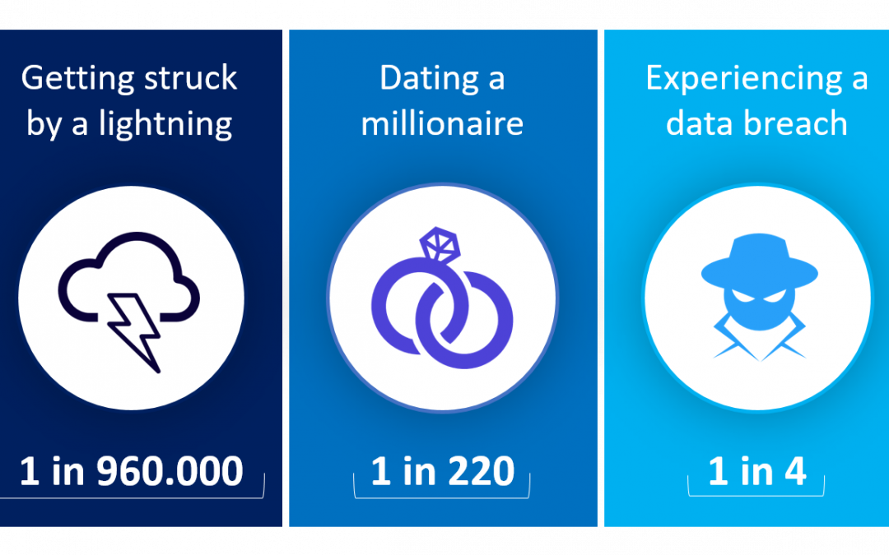
Data Breaches

Slide 67
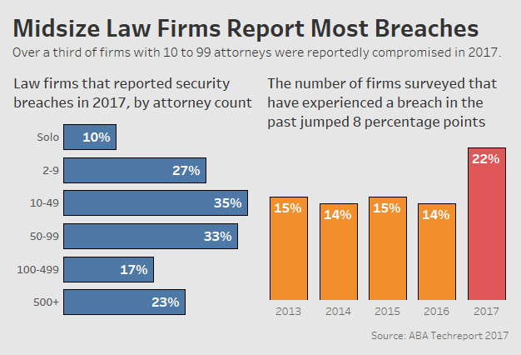

Slide 68
ABA Formal Op. 477R (5/21/2017)
“Securing Communication of Protected Client Information”
Reviews 2012 Model Rules Technology Amendments
Duty to prevent inadvertent or unauthorized disclosures
Reasonable efforts standard (safeguards)
(sensitivity, likelihood, cost, difficulty, ease to use)
Special protections by agreement, law or circumstances

Slide 69
What are “Reasonable Efforts”
Know your technology. (Security on?)
Know the information you are storing…and why.
Use software that the manufacturer is updating. (Not Windows XP, Windows 7)
Are you encrypting your communications?
Are you backing up your data?
Are you using the Cloud?
Are you working with reputable vendors?
Are you training your staff?

Slide 70
When Your Home is Now Your Office
Same security obligations exist.
Home systems are generally more vulnerable.
How are you backing up data from your home system?
Are you using your firm issued computer?
Be mindful of people in your home.

Slide 71
ABA Formal Op. 483 (10/17/2018)
“Lawyers’ Obligations After an Electronic Data Breach or Cyberattack”
  Before breach, develop data breach plan
  Must monitor for data breach
  Stop breach and restore systems
  Reasonably determine what occurred
  Provide notice of data breach to clients
  Notice must give sufficient information

Slide 72
Statutory Obligations
Alabama Data Breach Notification Act (6/1/2018)
* Applies to lawyers and law firms
* Deals with “SPII”
* Requires tech safeguards & timely notice
HIPPA
Gramm Leach Bliley Act
Sarbanes Oxley

Slide 73

Do Not Use Technology to Avoid the Rules

Slide 74
Do Not Use Technology to Avoid the Rules
Pro Hac Vice.
Do not listen in on conversations NOT meant for you.
Do not get clients to do things that you could not do yourself.

Slide 75

Beware of Metadata
(or Be Aware of Metadata) ?

Slide 76
Ethical Propriety of Metadata Mining
Formal Opinion 2007 – 02:
“Lawyers have a duty under Rule 1.6 to use reasonable care when transmitting electronic documents to prevent the disclosure of metadata containing client confidences or secrets.”

Slide 77
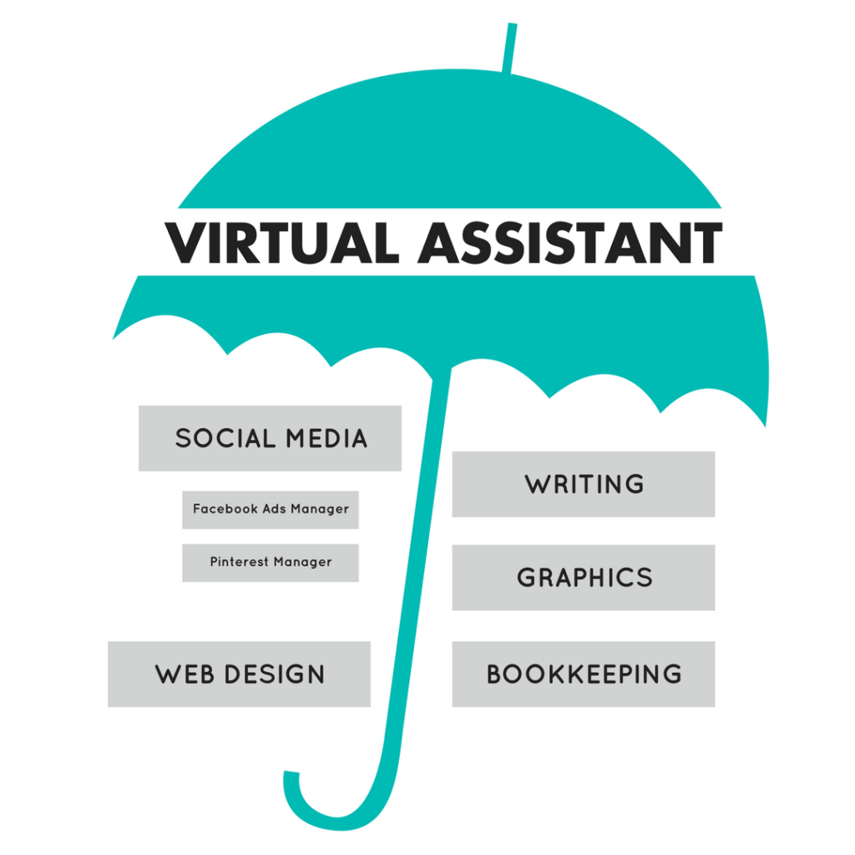
Ethics of Virtual Assistants and other Collaborative Arrangements

Slide 78
What are they going to do for you?
Social Media
Word Processing
Billing/Collections
Personal business

Slide 79
Are they Competent?
Should they being doing the type of work assigned?
Have you made sure they have proper training and skills?
Is the computer equipment they are using safe?
Are you transmitting information safely?
Do you need client permission?

Slide 80
How are they going to be paid?
Rule 5.4. Professional Independence of a Lawyer.
A lawyer or law firm shall not share legal fees with a nonlawyer, except that:
(3) A lawyer or law firm may include
nonlawyer employees in a compensation
or retirement plan, even though the plan
is based in whole or in part on a profit- sharing arrangement.

Slide 81
You are Responsible !
Rule 5.3. - Responsibilities Regarding Nonlawyer Assistants.
With respect to a nonlawyer employed or retained by or associated with a lawyer:
A partner in a law firm shall make reasonable efforts to ensure that the firm has in effect measures giving reasonable assurance that the person's conduct is compatible with the professional obligations of the lawyer;
A lawyer having direct supervisory authority over the nonlawyer shall make reasonable efforts to ensure that the person's conduct is compatible with the professional obligations of the lawyer; and

Slide 82
You are Responsible !
Rule 5.3. - Responsibilities Regarding Nonlawyer Assistants.
With respect to a nonlawyer employed or retained by or associated with a lawyer:
A lawyer shall be responsible for conduct of such a person that would be a violation of the Rules of Professional Conduct if engaged in by a lawyer, if:
(1) The lawyer orders or, with the knowledge of the specific conduct, ratifies the conduct involved; or
(2) The lawyer is a partner in the law firm in which the person is employed, or has direct supervisory authority over the person, and knows of the conduct at a time when its
consequences can be avoided or mitigated but fails to take reasonable remedial action.

Slide 83

Other Collaborative Arrangements

Slide 84
Other Collaborative Arrangements
Financing
Staffing
Joint legal work
Modern trend is to allow “non-lawyer business arrangements.”

Slide 85
Other Collaborative Arrangements
Rule 5.4. Professional Independence of a Lawyer.
(b) A lawyer shall not form a partnership with a nonlawyer if any of the activities of the partnership consist of the practice of law.
(c) A lawyer shall not permit a person who recommends, employs, or pays the lawyer to render legal services for another to direct or regulate the lawyer's professional judgment in rendering such legal services.
(d) A lawyer shall not practice with or in the form of a professional corporation or association authorized to practice law for a profit, if:
(1) A nonlawyer owns any interest therein…
(2) A nonlawyer is a corporate director or officer thereof; or
(3) A nonlawyer has the right to direct or control the professional
judgment of a lawyer.

Slide 86

Often Comes Down to:
“Your Professional Judgment”

Slide 87

My Client is Having a Crisis…
What Do I Do?

Slide 88
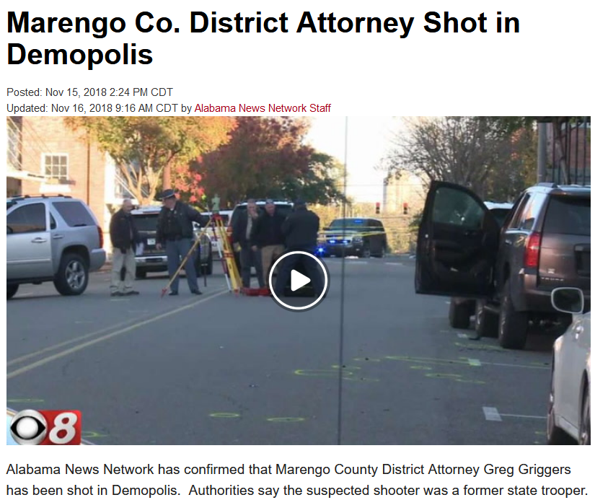
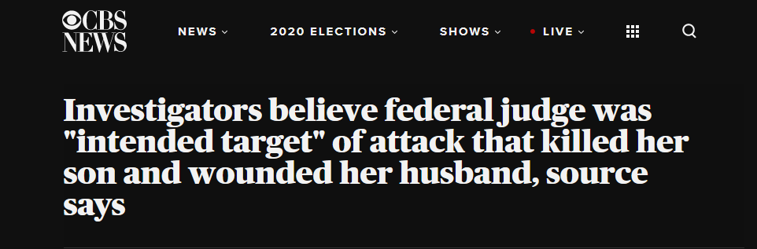

Slide 89
Rule 1.6(b) exceptions
Rule 1.6 CONFIDENTIALITY OF INFORMATION
(b) A lawyer may reveal such information to the extent the lawyer reasonably believes necessary:
(1) to prevent the client from committing a criminal act that the lawyer believes is likely to result in imminent death or substantial bodily harm;…

Slide 90
Office of General Counsel
Bankruptcy at the Beach
September 10, 2021
Roman.Shaul@alabar.org
Alabama State Bar
Montgomery, Alabama

