Slide 1
Office of General Counsel
Bankruptcy at the Beach
June 3, 2021
Roman.Shaul@alabar.org
Alabama State Bar
Montgomery, Alabama

Slide 2
…at the Alabama State Bar

Slide 3
ASB Feature Presentation
Next Bar President – Gibson Vance.
2. President –Elect Brannon Buck. (Taze Shepard is current President until June 26th)
3. Please check out “Member Benefits.” https://www.alabar.org/members/benefits/
Sign up for “The Scoop.” – Melissa.Warnke@AlaBar.org
5. Chris Colee – Practice Management Assistance Director - Chris.Colee@alabar.org
6. Annual Meeting – Sandestin – June 22-26, 2022

Slide 5
Keller Doctrine

Slide 6
The Keller Doctrine
Keller v. State Bar of California, 496 U.S. 1 (1990)
Facts of the case:
The California State Bar was an “Integrated Bar” or “Mandatory Bat.”
To practice law in California you must be a member of, and pay dues to the State Bar.
California used dues to lobby the legislature; filed amicus briefs; and funded political and ideological causes.

Slide 7
What is a State Bar?
The trial court said the State Bar was like a governmental agency.
Therefore, it had a right to engage in political speech under the 1st Amendment.
The California Court of Appeals said the State Bar was more like a Labor Union, and was therefore, limited in how it could use it’s member’s.
The U.S. Supreme Court found . . .

Slide 8
“Integrated Bars” are subject to labor union rules
Just as compelled association in a labor union is justified for the purposes of Collective Bargaining, so to is compelled association in a State Bar “justified by the State's interest in regulating the legal profession and improving the quality of legal services.”

Slide 9
How can the Alabama State Bar use dues under Keller?
Under the Keller Doctrine an “Integrated” State Bar can only use mandatory membership dues to fund activities directly related to the Bar’s stated purpose:
Regulating the legal profession;
Improving the quality of legal services.

Slide 10
How does the Alabama State Bar allocate the majority of the member dues?
To effectuate our Core functions, which are:
Admissions & Licensing
Meeting our regulatory responsibilities to the public and the profession via the disciplinary system.

Slide 11
Texas Litigation: Fifth Circuit Court of Appeals Opinion
Keller revisited . . .
McDonald, et al, v. Longley, et al, 2021 U.S. App. LEXIS 19882, __ F.4th __ (5th Cir., July 2, 2021)

Slide 12
Texas Litigation: What is it About?
Texas is a “mandatory” or “integrated” bar (like Alabama and 31 total states).
3 members of the TX Bar sued the Bar president and certain directors of the State Bar of TX in federal court alleging violations of §1981 and 1988 concerning alleged infringements of their First Amendment rights of free speech and freedom of association.

Slide 13
Texas Litigation: What is it About?
Specifically, the plaintiffs allege that TX law requires them to be a member of the Bar and to pay dues as a prerequisite to practicing law in TX. Therefore, they argue that the forced membership and dues requires them to support certain political speech and activities that run against their personal beliefs.
They challenged specific acts of the Bar.

Slide 14
Texas Litigation: What is it About?
Activities challenged by plaintiffs were:
Legislative Program
Office of Minority Affairs
Legal Access Division (Pro Bono program)
Access to Justice Commission
Annual Meeting
CLE Programs
Texas Bar Journal

Slide 15
Texas Litigation: How did the Court rule?
The 5th Circuit acknowledged Supreme Court precedent that allowed mandatory bars to expend funds in essentially two ways:
To regulate the legal profession; and,
Improve the quality of legal services.

Slide 16
Texas Litigation: How did the Court rule?
Activities challenged by plaintiffs were:
Legislative Program (only partially approved)
Office of Minority Affairs (approved)
Legal Access Division (Pro Bono program)(approved)
Access to Justice Commission (only partially approved)
Annual Meeting (approved)
CLE Programs (approved)
Texas Bar Journal (approved)

Slide 18
Duty of Confidentiality
Rule 1.6 (a) CONFIDENTIALITY OF INFORMATION
(a) A lawyer shall not reveal information relating to representation of a client unless the client consents after consultation, except for disclosures that are impliedly authorized in order to carry out the representation…

Slide 19
Client with Diminished Capacity - Rule 1.14
Try and maintain a normal relationship if possible.
Can disclose limited information if the lawyer reasonably believes the client is at risk of substantial physical or financial harm unless some action is taken.
The lawyer can consult with individuals/entities to protect the client, including appointment of conservator or guardian.
Not a blanket waiver of confidentiality.

Slide 20
Let’s talk about YOUR…

Slide 21
Can an Alabama Lawyer be sanctioned for private conduct? Answer: YES

Slide 22
Rule 8.4, Ala. R. Prof. C. Misconduct
It is professional misconduct for a lawyer to:
…
(d) Engage in conduct that is prejudicial to the administration of justice
…
(g) engage in any other conduct that adversely reflects on his fitness to practice law.

Slide 23
Common Violations of Alabama Rule 8.4(g)
Attorneys getting arrested.
Social Media Outbursts.
Outrageous conduct not subject to a criminal penalty.

Slide 24
Recent Example
Attorney initially spoke with a male African-American representative before being transferred to a female representative. During the recorded conversation with the female representative, attorney stated:
“I’ll tell you what; look here you fucking bitch. I’m just going to haul you into fucking court. Go fuck yourself, you fucking cunt. You’re about as much help as that fucking n****r that I spoke with. “
Attorney later exclaimed: “Fuck you. Fuck you, you bitch.”
Attorney also stated as follows:
“There’s some . . . I promise you there’s somebody at Samsung that’s an Asian, that’s above you. No lady, no woman at Samsung is the highest level. I can promise you that. So there is somebody above you. I would like to speak with them, please.”
Attorney threatened the female representative when he stated,
“I will shoot you in the fucking head . . . I want you to go fuck a dick.

Slide 25
Social Media and Legal Ethics

Slide 27
First – Don’t Post While Angry

Slide 28
Second - Don’t Post While Drinking

Slide 29
Third –Don’t Post Disparagingly about Clients

Slide 30
Example
The Office of General Counsel received copies of screen shots from a website, www.avvo.com. The website allows clients to post comments regarding their lawyers. On the website, a former client posted an anonymous negative review.
The Alabama attorney responded to the negative review by posting an online response attacking his former client and revealing confidential information.
The lawyer posted that… “the client was ignorant” . . . “had been charged with DUI, a drug charge, and also had a previous divorce case”… “the client had been locked up in the looney bin” for months due to “numerous and severe” psychological conditions. The lawyer also told the client to “show some fortitude and man up boy.”

Slide 32
It is Ok to Post About Your Cases…But,
The Virginia Supreme Court held in Hunter v. Virginia State Bar, 744 S.E.2d 611 (Va. 2013), that confidentiality obligations have limits when weighed against a lawyer’s First Amendment protections.
Specifically, the court held that although a lawyer’s blog posts were commercial speech, the Virginia State Bar could not prohibit the lawyer from posting non-privileged information about clients and former clients without the clients’ consent where (1) the information related to closed cases and (2) the information was publicly available from court records and, therefore, the lawyer was free, like any other citizen, to disclose what actually transpired in the courtroom.

Slide 33
Fourth – Don’t Post About the Judge
Multiple federal prosecutors admitted to posting anonymously about several judges in pending investigations and cases.
Lawyer sends purported suicide note in which he makes several disparaging and reprehensible comments about several judges and lawyers.
A lawyer agreed to a public reprimand for harshly criticizing a judge in a blog post, using phrases such as “evil, unfair witch” and “seemingly mentally ill.”

Slide 34
Fifth – Don’t Post About People Not Your Client
Assistant prosecutor disciplined for posting threats against his boss on Facebook.
A prosecutor was disciplined for commenting on Facebook during an attempted murder trial about “keeping the streets safe from Somalis.”
A lawyer posted nude photos of his ex-girlfriend--a prosecutor herself --on Twitter

Slide 35
Sixth – Don’t Post Credentials You Do Not Have!
A lawyer received a public reprimand for violating advertising rules by false and misleading statements about his qualifications, such as listing 50 practice areas in which he had little or no experience.

Slide 36
Seventh - Avoid Communications with Represented Parties
Generally, you cannot “friend” an opposing party to gain access to their social media content. However, most jurisdictions allow you to view whatever is publicly available.
Similarly, do not accept a friend request from opposing parties.

Slide 37
Important Tip on Social Media Use

Slide 38
Beware of Creating an Attorney-Client Relationship
ABA Formal Opinion 10-457 recognized that enabling communications between prospective clients and lawyers, websites may give rise to inadvertent attorney-client relationships and trigger ethical obligations to prospective clients under MRPC 1.18.
The interactive nature of social media - inviting and responding to comments creates a real risk of inadvertently forming attorney-client relationships.

Slide 39
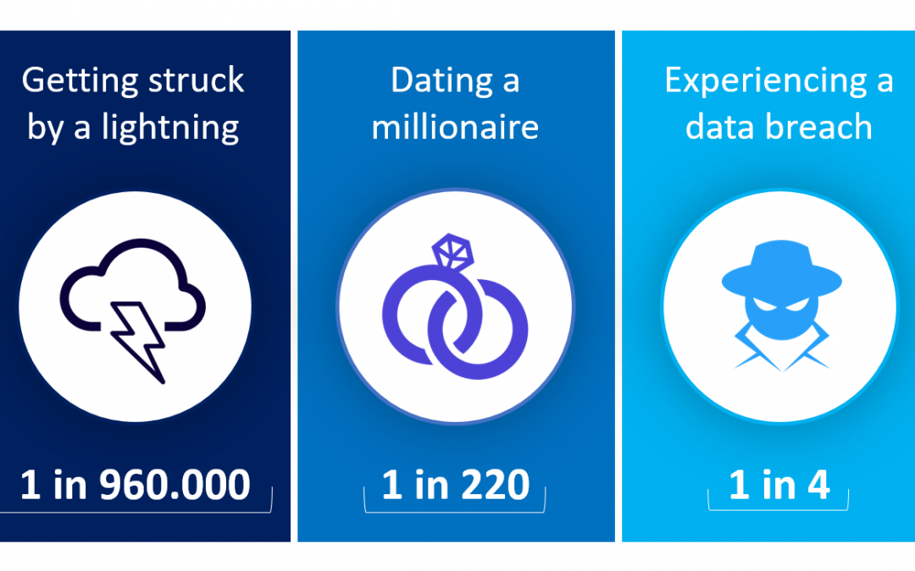
Data Breaches

Slide 40
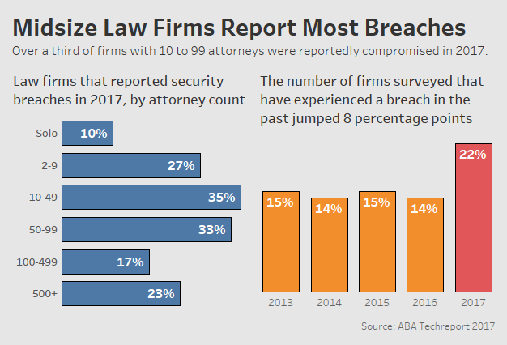

Slide 41
ABA Formal Op. 477R (5/21/2017)
“Securing Communication of Protected Client Information”
Reviews 2012 Model Rules Technology Amendments
Duty to prevent inadvertent or unauthorized disclosures
Reasonable efforts standard (safeguards)
(sensitivity, likelihood, cost, difficulty, ease to use)
Special protections by agreement, law or circumstances

Slide 42
What are “Reasonable Efforts”
Know your technology. (Security on?)
Know the information you are storing…and why.
Use software that the manufacturer is updating. (Not Windows XP, Windows 7)
Are you encrypting your communications?
Are you backing up your data?
Are you using the Cloud?
Are you working with reputable vendors?
Are you training your staff?

Slide 43
ABA Formal Op. 483 (10/17/2018)
“Lawyers’ Obligations After an Electronic Data Breach or Cyberattack”
Before breach, develop data breach plan
Must monitor for data breach
Stop breach and restore systems
Reasonably determine what occurred
Provide notice of data breach to clients
Notice must give sufficient information

Slide 44
Statutory Obligations
Alabama Data Breach Notification Act (6/1/2018)
* Applies to lawyers and law firms
* Deals with “SPII”
* Requires tech safeguards & timely notice
HIPPA
Gramm Leach Bliley Act
Sarbanes Oxley

Slide 45
When Your Home is Now Your Office

Slide 46
When Your Home is Now Your Office
Same security obligations exist.
Home systems are generally more vulnerable.
How are you backing up data from your home system?
Are you using your firm issued computer?
Be mindful of people in your home.

Slide 47
Beware of Metadata (or Be Aware of Metadata) ?

Slide 48
Ethical Propriety of Metadata Mining
Formal Opinion 2007 – 02:
“Lawyers have a duty under Rule 1.6 to use reasonable care when transmitting electronic documents to prevent the disclosure of metadata containing client confidences or secrets.”

Slide 49
Ethics of Virtual Assistants and other Collaborative Arrangements

Slide 50
What are they going to do for you?
Social Media
Word Processing
Billing/Collections
Personal business

Slide 51
Litigation Issue

Slide 52
“I represent this person for the purposes of this deposition.”
1. You probably don’t . . .
2. Must comply with Rule 1.2 & Rule 4.2

Slide 53
Rule 1.2(c): Limited Scope of Representation
(c) A lawyer may limit the scope of the representation if the limitation is reasonable under the circumstances and the client gives informed consent.
The client’s informed consent must be confirmed in writing unless:
1. Advice is solely a telephone consultation;
2. The representation is provided by a nonprofit legal-services program lawyer or you are participating in a pro bono program approved by the ASB and the lawyer’s representation consists solely of providing information and advice or the preparation of legal documents; or
3. Court appoints the attorney for a limited purpose set forth in an order.

Slide 54
Rule 4.2 (b) Communication with Person Represented by Counsel
(b) A person to whom limited-scope representation is being provided or has been provided in accordance with Rule 1.2(c) is considered to be unrepresented for purposes of this rule unless the opposing lawyer has been provided with a written notice of the limited-scope representation.
If such notice is provided, the opposing lawyer shall not communicate with the person regarding matters designated in the notice of limited-scope representation without consent or authorization as provided by Rule 4.2(a).

Slide 55
Recent Fact Pattern
Attorney represents Corporation A and Corporation B being sued over the sale of certain assets.
Attorney meets with an employee who has worked for both corporations and was intimately involved in the sale of the assets.
Attorney meets with the employee the day before the deposition to prep him. After the prep, tells the employee he only represents the corporations.
At the deposition, he asserts attorney-client privilege and instructs employee not to answer a question. On a break, he gives the employee legal advice.
Corporation A and the employee settle before trial. Corporation B goes to trial. At trial, attorney blames fraud on employee.

Slide 56
Most Common Disciplinary Issues for Bankruptcy Lawyers

Slide 57
You MUST Communicate With Your Clients

Slide 58
Rule 1.4 Communication
(a) A lawyer shall keep a client reasonably informed about the status of a matter and promptly comply with reasonable requests for information.
(b) A lawyer shall explain a matter to the extent reasonably necessary to permit the client to make informed decisions regarding the representation.

Slide 59
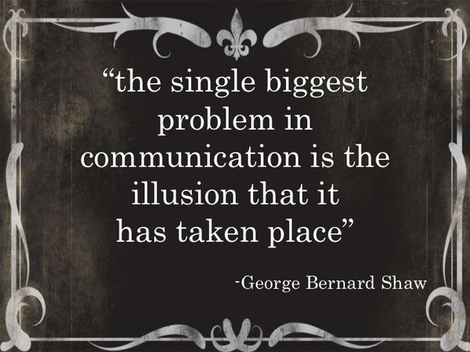

Slide 60
Procrastination kills !

Slide 61
Rule 1.3 Diligence
A lawyer shall not willfully neglect a legal matter entrusted to him or her.

Slide 62
Rule 3.2 Expediting Litigation
A lawyer shall make reasonable efforts to expedite litigation consistent with the interests of the client.

Slide 63
Truthfulness in Proceedings

Slide 64
Rule 3.3: Candor Toward the Tribunal
(a) A lawyer shall not knowingly: (1) Make a false statement of material fact or law to a tribunal;
(2) Fail to disclose a material fact to a tribunal when disclosure is necessary to avoid assisting a criminal or fraudulent act by the client; or, (3) Offer evidence that the lawyer knows to be false. If a lawyer has offered material evidence and comes to know of its falsity, the lawyer shall take reasonable remedial measures.

Slide 65
Rule 3.3: Candor Toward the Tribunal
(b) The duties stated in paragraph (a) continue to the conclusion of the proceeding, and apply even if compliance requires disclosure of information otherwise protected by Rule 1.6.
(c) A lawyer may refuse to offer evidence that the lawyer reasonably believes is false.
(d) In an ex parte proceeding other than a grand jury proceeding, a lawyer shall inform the tribunal of all material facts known to the lawyer which will enable the tribunal to make an informed decision, whether or not the facts are adverse.

Slide 66
Lying Client Example
Your client tells you they are not going to disclose certain information because “no one will ever know.”
After arriving back at your office, the client informs you that they did not answer everything quite as truthful as they could have.

Slide 67
Rule 3.3 Remedial Measures
Counsel the employee to be truthful.
Notify other client(s).
Disavow certain pleadings if offered in that form.
Notify the court.
Client may still dispute what he told the lawyer. (Must withdraw)

Slide 68
Rule 3.3 Things to Think About
Do you “know” client is lying? (actual knowledge, mere suspicion is not enough)
Cannot ignore an obvious falsehood.
What does the “end of the proceeding “ language mean? (Can disclosure remedy the effect of the fraudulent conduct?)

Slide 69
Splitting Fees

Slide 70
Failure to Check for Bankruptcy Filing

Slide 71
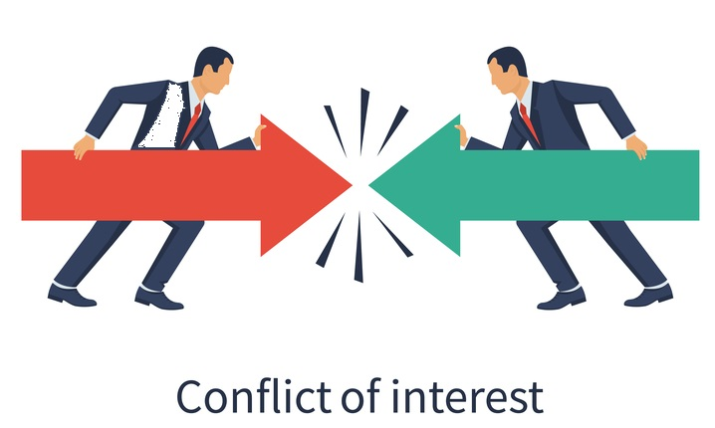

Slide 72
Rule 1.7 Conflict of Interest: General Rule
(a) A lawyer shall not represent a client if the representation of that client will be directly adverse to other clients, unless:
(1) The lawyer reasonably believes the representation will not adversely affect the relationship with the other client; and
(2) Each client consents after consultation.

Slide 73
Rule 1.7 Conflict of Interest: General Rule
(b) A lawyer shall not represent a client if the representation of that client may be materially limited by the lawyer’s responsibilities to another client or a third person, or by the lawyer’s own interest, unless:
(1) The lawyer reasonably believes the representation will not be adversely affected; and
(2) The client consents after consultation. When representation of multiple clients in a single matter is undertaken, the consultation shall include explanation of the implications of the common representation and the advantages and risks involved.

Slide 74
Rule 1.9 Conflict of Interest: Former Client.
A lawyer who has formerly represented a client in a matter shall not thereafter: (a) Represent another person in the same or a substantially related matter in which that person's interests are materially adverse to the interests of the former client, unless the former client consents after consultation; or (b) Use information relating to the representation to the disadvantage of the former client except as Rule 1.6 or Rule 3.3 would permit or require with respect to a client or when the information has become generally known.

Slide 75
Conflict Examples
You represent a husband and wife at the time of filing the petition, but they later divorce.
You represented a husband and wife together in their first bankruptcy. Years later one of the spouses wants you to represent her in a different bankruptcy.
When additional services may be needed other than what was originally covered in the initial agreement.

Slide 77
Rule 1.2(c): Limited Scope of Representation
(c) A lawyer may limit the scope of the representation if the limitation is reasonable under the circumstances and the client gives informed consent.
The client’s informed consent must be confirmed in writing unless:
1. Advice is solely a telephone consultation;
2. The representation is provided by a nonprofit legal-services program lawyer or you are participating in a pro bono program approved by the ASB and the lawyer’s representation consists solely of providing information and advice or the preparation of legal documents; or
3. Court appoints the attorney for a limited purpose set forth in an order.

Slide 78
Other Conflict Examples
You are retained to represent a corporation, but the President and CEO wants you (or a member of your firm) to represent them in a bankruptcy.
What if the CEO wants representation in a separate matter ?
Specific questions about legal obligations imposed by statutes and rules.

Slide 79
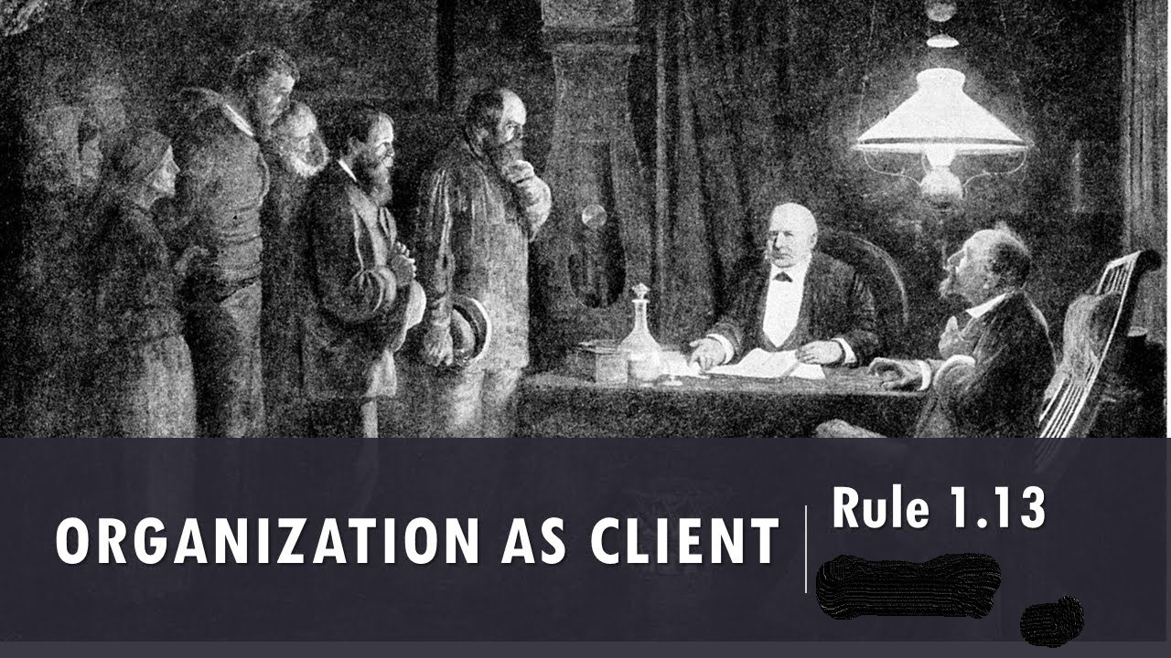

Slide 80
Organization as “The Client”
Rule 1.13 (a) A lawyer employed or retained by an organization represents the organization acting through its duly authorized constituents.

Slide 81
Organization as “The Client”
Conflicts within the organization.
Make it clear who you represent.
Get permission of appropriate official to represent employees, officers, officals.
If a conflict later develops, you may have to withdraw from representing all parties.

Slide 83
Don’t Rely on Your Friends for Ethics Advice

Slide 84
Rule 5.1 - Liability of Supervisory Lawyers
(c) A lawyer shall be responsible for another lawyer’s violation of the Rules of Professional Conduct if:
The lawyer orders or, with knowledge of the specific conduct, ratifies the conduct involved; or
The lawyer…has direct supervisory authority over the other lawyer, and knows of the conduct at a time when its consequences can be avoided or mitigated but fails to take reasonable remedial action.

Slide 86
Why Get an Ethics Opinion?

Slide 87
Ethics Opinions
Alabama Rules of Disciplinary Procedure
Rule 18.
Conduct not subject to disciplinary action.
If, before engaging in a particular course of conduct, a lawyer makes a full and fair disclosure, to the Office of General Counsel, said inquiry shall be considered confidential. Additionally, if said lawyer receives a formal or informal opinion from the Office of General Counsel that the proposed conduct is permissible, such conduct shall not be subject to disciplinary action.

Slide 88
Office of General Counsel
Bankruptcy at the Beach
June 3, 2021
Roman.Shaul@alabar.org
Alabama State Bar
Montgomery, Alabama

